Slide 1
On the Challenge of Making Sense of Nordic Exclusionary Reasoning
“Racialization in the Nordic Countries”, University of Jyväskulä
Peter Hervik, professor
Center for the Study of Migration and Diversity (CoMID)
hervik@cgs.aau.dk
4 November 2015

Slide 2
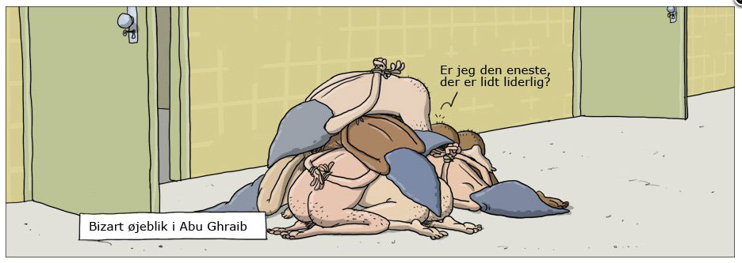
Politiken 4 August 2011, Wulffmorgenthaler

Slide 3
Susan Sontag
Instead of exlusive focusing on the objectivity and accuracy of an image to the object being represented, we suggest that the significance or impact of images may lie simply in our relationship to them:
the way we consume them,
forward them to friends or family, and
edit and recontextualize them ourselves

Slide 4
Souvenirs
Circulating pictures; it was all fun
Perhaps torture is more attractive, as something to record, when it has a sexual component

Slide 5
Entitlement Racism (Essed 2013, ENAR)
The perpetrators know, or could have known that their portrayals are offensive, but they do not see any reason to apologize or change their behaviour
They insist on the right to offend in the name of freedom, regardless of its impact on others
At the core of racism is the humiliation of the ‘other’ in order to elevate the self

Slide 6
Case 1. Blog related to tabloid-newspaper
“Radical Islam must be fought by several groups. It would do the debate on Islam good, if left-wingers and feminists would dare to object.”
Incident One: “18 year old Somali rapist”
Incident Two: “External examiner in high-school who refuses to greet female students”

Slide 7
“Refugees are welcome, stop Muslims” (maxp, 19 June 2013)
“Obviously, there is much between a handshake to the Paedophile Somali rapist from Gullestrup, but everything begins with a detail” (Henrik D., 10 June 2013)
”If you are a Muhammedanian, then you have taken the whole package” (Henrik D., 10 June 2013)
“We are in the process of a destruction of the European culture” (Rasmus, 20 June 2013)

Slide 8
Case 2. Public Radio website
”Drunk Student: Do I need to be sober at Hassan's place”
Sarah: The 10 immigrants in the class do not want drinking in their houses, so ”we cannot drink alkohol until after 8pm”

Slide 9
“Nobody should change Danish culture” (including drinking)
“Religion does not come first in this country”
”They have to bear the consequences”
“Then they cannot participate”
“They can do what they want”

Slide 10
“Facts that are inconsistent with the ideological scheme either go unnoticed or get explained away” (Gal 2005: 38).
Elements that do not fit its interpretive structure – that cannot be seen to fit – must be either ignored or transformed (ibid.)

Slide 11
Silent racism
Silent racism refers to unspoken negative thoughts, emotions, and attitudes regarding African Americans and other people of color that dwell in the minds of white people (Barbara Trepagnier 2001)

Slide 12
Silent racism is also close to Everyday racism (Philomena Essed)
Everyday racism refers to routine actions that go unquestioned by members of the dominant group which in some way discriminate against members of a racial or ethnic category (Essed 1991).
Silent racism differs from everyday racism in that silent racism refers solely to the thoughts, beliefs, and emotions white people have concerning African Americans and other people of color, not to discriminatory statements or actions taken against them

Slide 13
Silent racism corresponds to White privilege (David Wellman)
Wellman maintains that the rationale used by white people to justify their relative location to blacks in society is due to the preservation of privilege (1977 & 1993)
By definition, people who defend white privilege attempt to maintain the racial formation, not change it

Slide 14
Susan Gal & Judith Irvine
Fractal recursions are similarities between contrasts made at different scales, while differences are ignored (2000: 27)
“Fractual recursions involve the projection of an opposition, salient at some level of relationship onto some other level”

Slide 15
Comments on blogs and webnews
Time and again the authors construct categories of people, who are criticized for their “tolerance”, “historical openness”, “naivety”, and “humanitarian” points of view, while they make strong calls for more “authoritarianism”, “firmness”, “guts’” and “punishments”

Slide 16
(Neo)Racism
“a scavenger ideology, which gains its power from its ability to pick out and utilize ideas and values from other sets of ideas and beliefs in specific socio-historical contexts” (Solomos and Back, 1996) and assigning qualities to social groups that are fixed, made natural and confined within a pseudo-biologically defined culturalism (Barker 1981).

Slide 17
Culture Conflict
“As political and social hostility rooted in different systems of moral understanding.”
“Competing systems of moral understanding are by no means trifling, but always have a character of ultimacy to them. They are not merely attitudes that can change on a whim but basic commitments and beliefs that provide a source of identity, precisely this reason that political action rooted in these principles and ideals tends to be so passionate.” (Hunter 1991)

Slide 18
Narcissism (Freud 1930)
  - pathological focus on small differences between self and someone very close
  - creating distance between self and other
  - tokens of an uncertain self

Slide 19
The psychoanalytic notion of projective Chimera (as enemy image)
Tied to psychoanalytical projection:
”seeing in others that which one does not wish to become conscious of in oneself” (Smith 1999:218)
”the totalitarian character cannot admit admit to itself this wish for destruction, it projects the wish onto others, above all, the enemy which it has chosen, invented, or which has been invented for it by others, an enemy that is always imagined as inferior, just as it is dangerous. Fables of conspiracies and other evil things are spread out” (Horkheimer quoted in Smith)

Slide 20
Self-regard depends upon and in turn exacerbates intolerance.
The particular property of the narcissist gaze is that it glances up at the Other only to confirm its difference.
Does not engage itself with the Other in any real sense.
Narcissism is uninterested in others except to the extent that they reflect back upon himself.
What is different is rejected if it fails to confirm the narcissist in his self-opinion.

Slide 21
Appadurai’s “Predatory narcissism” (2006 – Fear of Small Numbers)
  Elimination of difference itself

Slide 22
Predatory identities
”Those identities whose social construction and mobilization require the extinction of other, proximate social categories, defined as threats to the very existence of some group, defined as a we”
Methods:
Portraying oneself as a threatened majority
”We could beocme a minority in our own country”

Slide 23
Tipping Points:
Capture of the state by racist/natinalist parties/groups
Census tools and techniques and their ethnicized interpretation
Felt lack of fit between political and ethnic borders
Campaigns of fear
Fear of small numbers

Slide 24
Freud quoted in Ignatieff (p 48)
“it is precisely the minor differences in people who are otherwise alike that form the basis of feelings of strangeness and hostility between them”
It is precisely because the differences between groups are minor that they much be expressed aggressively.
The less substantial the differences between two groups, the more they both struggle to portray those differences as absolute
“it would be tempting to pursue this idea and to derive from this ‘narcissism of minor differences’ the hostility which in every human relation we see fighting against feelings of fellowship and overpowering the commandment that all men should love one another.” (Ignatieff 1998 – Warrior’s Honor”

Slide 25
“Nationalism is a kind of narcisissm”
“A nationalist takes the neutral facts about a people – their language, habitat, culture, tradition, and history – and turns these facts into a narrative, whose purpose is to illuminate the self-consciousness of a group, to enable them to think of themselves as a nation with a claim to self-determination. A nationalist, in other words, takes “minor differences”- indifferent in themselves – and transforms them into major differences. So traditions are invented (p 50)

Slide 26
“The problem with nationalism is not the desire for self-determination itself, but the epistemological illusion that you can be at home, you can be understood, only among people like yourself ...
What is wrong with nationalism is not the desire to be master in your own house, but the conviction that only people like yourself deserve to be in the house” (p 59)

Slide 27
The root of intolerance lies in our tendency to overvalue our own identities; by overvalue, I mean we insist that we have nothing in common, nothing to share. At the heart of this insistence lurks the fantasy of purity, of boundaries that can never be crossed.” (Ignatieff p62)
Or, call it “the anxiety of incompleteness”, the “fear of small numbers”

Slide 28
“Anxiety of Incompleteness” ..
Anxiety and anger are expressed in BLAME
Blame is the result of the desire to make the other party responsible
“Fear” follows a similar pattern – feeding the idea of defense and feeding the idea of revenge

Slide 29
Conclusion
With the lack of full awareness this is where we find hegemonic representations, those representations of the world that “are so habituated, so deeply inscribed in everyday routine, that they may no longer be seen as forms of control – or seen at all," (Strauss and Quinn 1997:39).

